Slide 1
CS 115 Project
Theo Guidroz

Slide 2
Design and test plan

Slide 3
Classes Created
Vehicle
TollBoothLine
Simulator
SimulatorClient

Slide 4
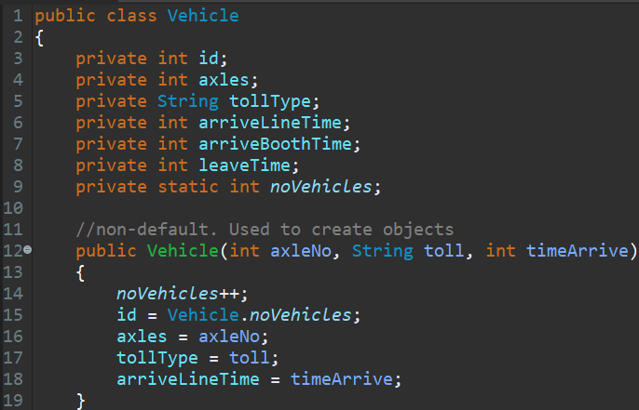
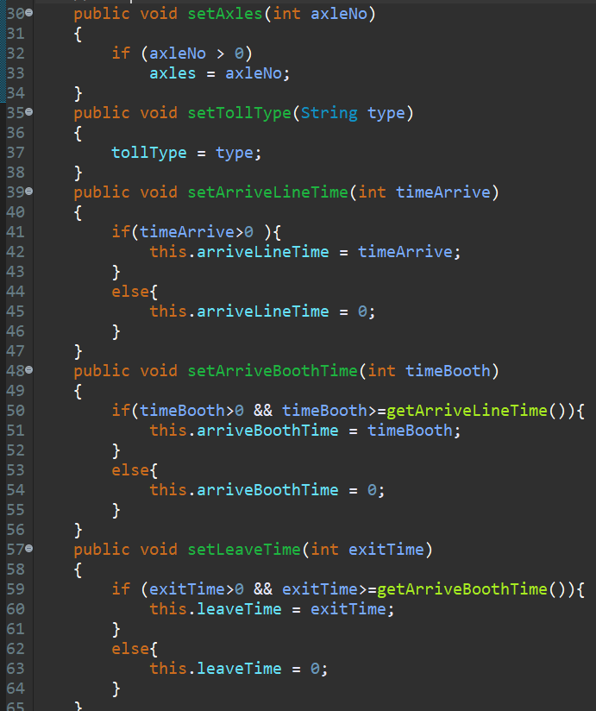
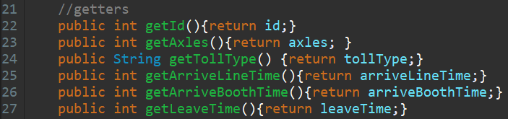
Class: vehicle
1.
3.
Creates an object vehicle with argument:
Number of axle
Toll type
Arrive Time
Associates unique ID to the object.
2.
Returns a characteristic
Sets a characteristic

Slide 5
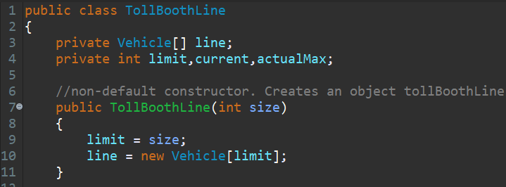
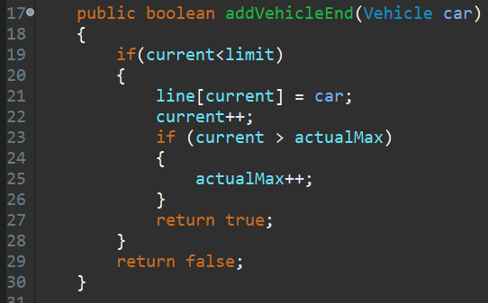
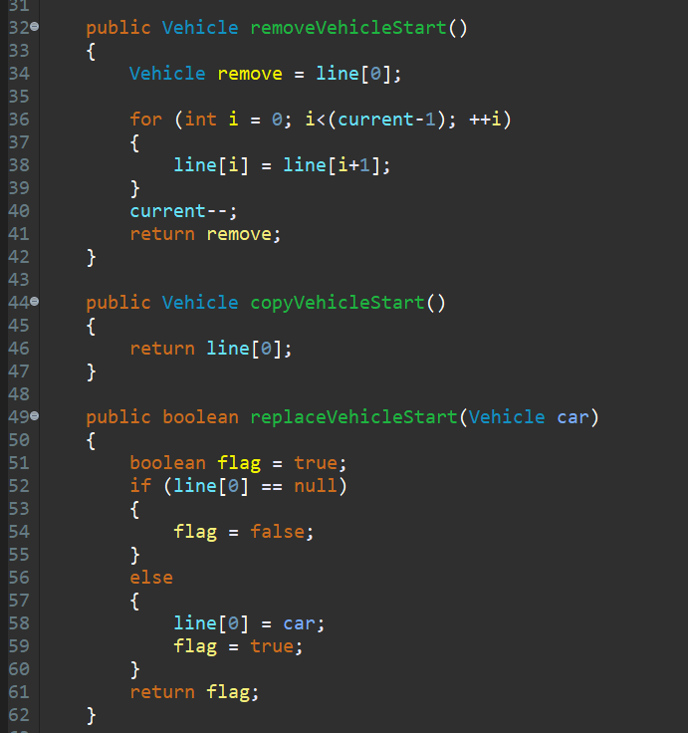

Class: TollBoothLine
1.
3.
Adds a vehicle object at the end of the array.
Removes the first object and moves the rest up the list.
Creates an object with argument size.
Creates an array of the size attributed
Copies the first object.
Returns a characteristic
Replaces the first object of the array.
2.

Slide 6
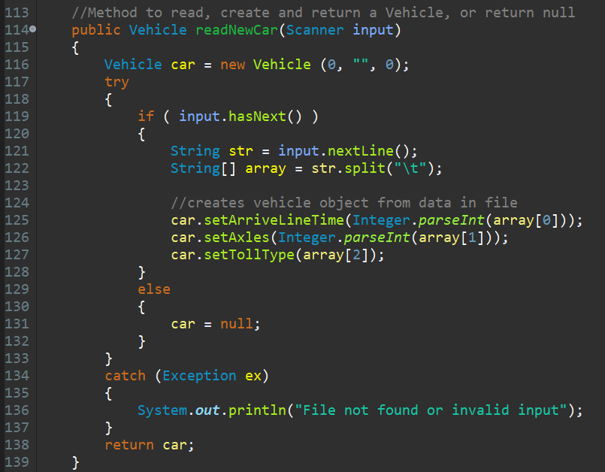
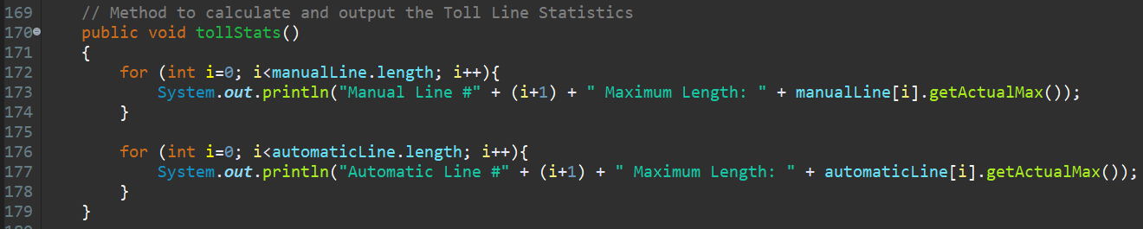
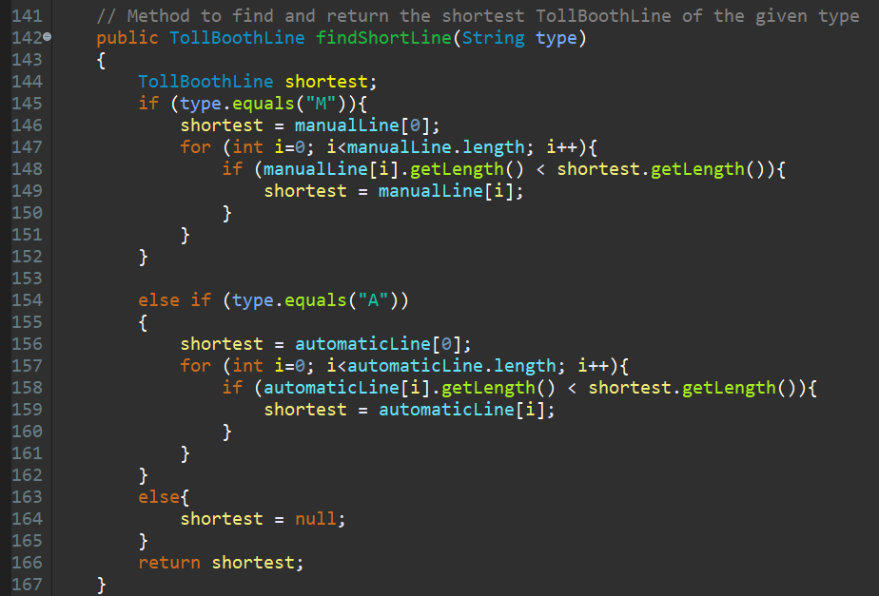
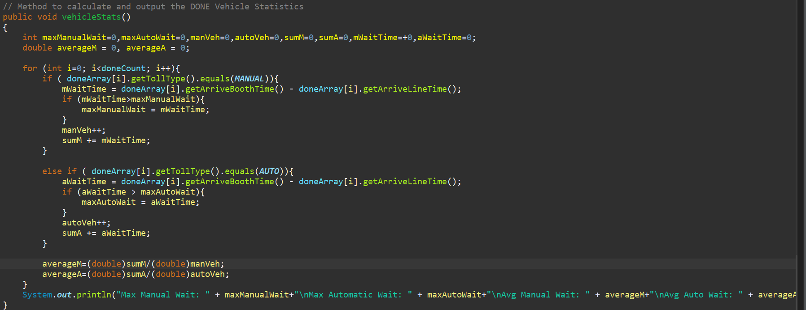
Class: simulator
Reads data and creates vehicle objects
1.
3.
Prints the length of the longest automatic booth and manual booth.
Prints the longest wait time on the manual booth and automatic booth.
Prints the average wait time.
Returns the shortest booth line.
4.
2.

Slide 7
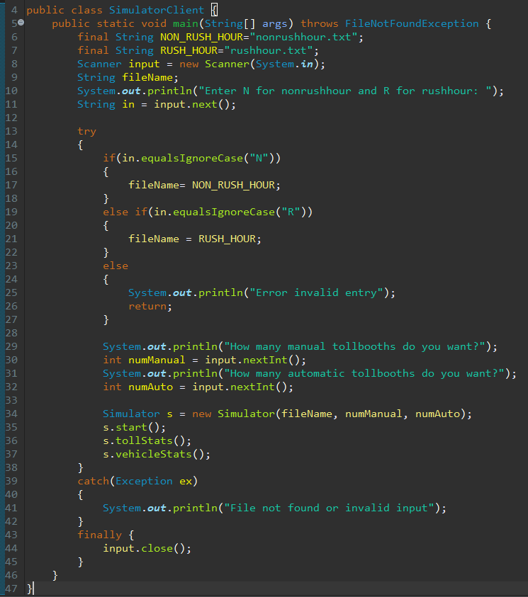
Class: simulatorclient
Gives the option of N and R depending on which file to use.
Asks the number of lines wanted.
Prints the statistics
Closes the user input option.

Slide 8
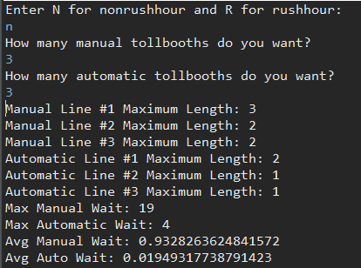
Test case

Slide 9
Analysis
Since most vehicles have 2 axles and automatic booths are faster, more automatic booths than manual booths should be installed.
I would recommend a ratio of 6:1 for automatic booths : manual booth.
In 10 years the number of booths should double if the amount of vehicles double.

